Slide 1

WELCOME
Mobile And Application Development

Slide 2

ListView
Mobile And Application Development
Practical
Instructor: Muhammad Naeem Khan

Slide 3
What is List?
A list is any information displayed or organized in a logical or linear formation.
It is a view which groups several items and display them in vertical scrollable list.

Slide 4
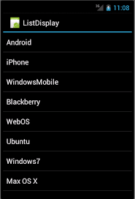
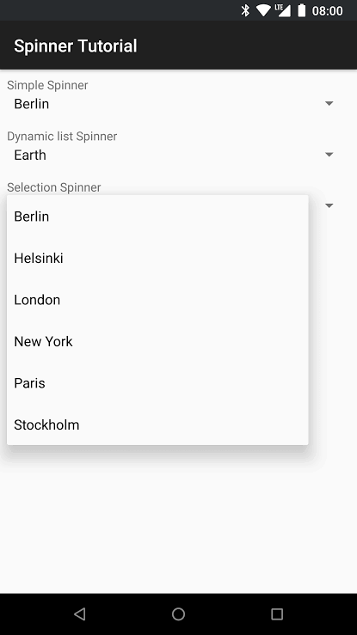
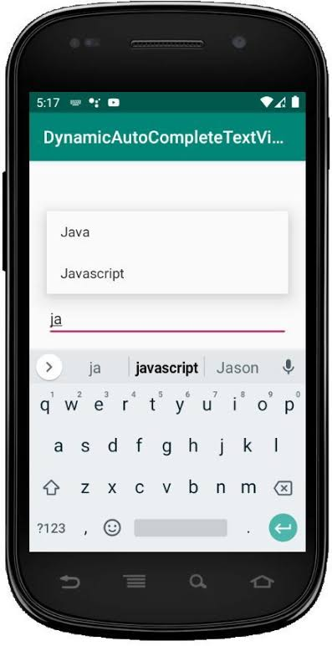
What is List?

Slide 5
How to create ListView?
XML Code | Java Code
<ListView Android:layout_width = “match_parent” Android:layout_width = “wrap_content” Android:id = “@+id/listview”/> | ListView listview; ArrayList<String> arrName = new ArrayList(); int[] arrNo = new int[] {1,2,3,4,5}; listview = findViewById(R.id.listview); arrName.add(“Naeem”); arrName.add(“Khan”); ArrayAdapter<String> adapter = new ArrayAdapter<>(getApplicationContext(),android.R.layout.simple_list_item_1,arrName); listView.setAdapter(adapter); Listview.setOnItemClickListener(new AdapterView. OnItemClickListener(){ if(position = = 0) Toast.makeText(“Clicked First Item”); }

Slide 6
How to create Spinner?
XML Code | Java Code
<ListView Android:layout_width = “match_parent” Android:layout_width = “wrap_content” Android:id = “@+id/listview”/> | Spinner spinner; ArrayList<String> Country = new ArrayList(); listview = findViewById(R.id.spinner); spinner.add(“Naeem”); spinner.add(“Khan”); ArrayAdapter<String> spinnerAdapter = new ArrayAdapter<>(this,android.R.layout.simple_list_item_1,Country); spinner.setAdapter(spinnerAdapter);

Slide 7
Assignment
Create a list for AutoComplete

Slide 8
Thank You

